Slide 1


Social Media Content Genuineness and
Identification of abusive content
Jishnu.B 20P122
Suwinkumar.T 20P156
Tanush.K 20P157
Udhayarajan.M 20P158
Mentor:
Dr.S.Arul Antran Vijay ASP/CSE

Slide 2
Problem Statement
The goal of this project is to develop a system that can assess the genuineness of social media content and identify abusive and violent content.
To identify and flag the explicit content over social media.

Slide 3
Demerits
Spread of misinformation
Trust issues
Online harassment and abuse
Negative impact on mental health

Slide 4
Objective
The project will involve using ML and AI techniques to classify social media posts into genuine or potentially misleading categories.
Image / Video Analysis using CNN models to analyse visual content for identification of explicit content
Also analyse the User reported content data with AI and ML model for faster and lesser human intervention and to remove and flag the explicit content.

Slide 5
Existing System
Social media application uses a combination of human moderation, community reports to identification of the contents.
Teams of human moderators who manually review reported content
NLP to find the tags for keyword matching and flagging the explicit content on social medias slower and human intervention is needed.

Slide 6
Proposed Sytem
Deep Learning Architectures: Models like BERT (Bidirectional Encoder Representations from Transformers) can be fine-tuned for content moderation, enabling more accurate identification of genuine and explicit content.
Multimodal Fusion and Attention Mechanisms: Leveraging multiple modalities (text, images, video) and employing attention mechanisms can enhance content analysis and reduce reliance on human intervention
Advanced Filtering Techniques: Use efficient search algorithms to identify abusive hashtags and description and analyse them remove it while the content is uploaded in the social media to stop it from the getting into the internet.
Action Recognition: Action recognition algorithms aim to identify and classify human actions or activities within videos. By training models on labelled video datasets, they can detect violent or explicit actions within social media videos.

Slide 7
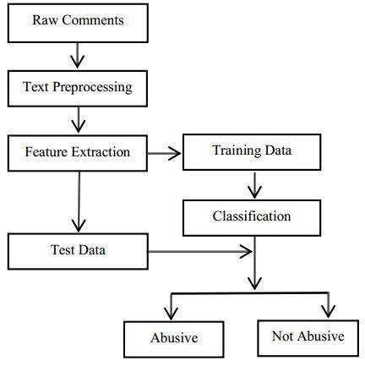
Flow Chart

Slide 8
Merits
Trust and credibility
User satisfaction
Positive brand image
User empowerment

Slide 9
Base paper and reference
SL.NO
1 | Aljabri, M., Zagrouba, R., Shaahid, A., Alnasser, F., Saleh, A. and Alomari, D.M., 2023. Machine learning-based social media bot detection: a comprehensive literature review. Social Network Analysis and Mining, 13(1), p.20. Aljabri, M., Zagrouba, R., Shaahid, A., Alnasser, F., Saleh, A. and Alomari, D.M., 2023. Machine learning-based social media bot detection: a comprehensive literature review. Social Network Analysis and Mining, 13(1), p.20. | Base Paper
2 | Haltigan, J.D., Pringsheim, T.M. and Rajkumar, G., 2023. Social media as an incubator of personality and behavioral psychopathology: Symptom and disorder authenticity or psychosomatic social contagion?. Comprehensive Psychiatry, 121, p.152362. | Reference 1
3 | Lavorgna, A., Ugwudike, P. and Tartari, M., 2023. Online sharenting: Identifying existing vulnerabilities and demystifying media reported crime risks. Crime, Media, Culture, p.17416590221148448. | Reference 2
4 | Chhabra, A. and Vishwakarma, D.K., 2023. A literature survey on multimodal and multilingual automatic hate speech identification. Multimedia Systems, pp.1-28. | Reference 3

Slide 10
Base paper and reference (Contd.,)
SL.NO
5 | Prabhu Kavin, B., Karki, S., Hemalatha, S., Singh, D., Vijayalakshmi, R., Thangamani, M., Haleem, S.L.A., Jose, D., Tirth, V., Kshirsagar, P.R. and Adigo, A.G., 2022. Machine learning-based secure data acquisition for fake accounts detection in future mobile communication networks. Wireless Communications and Mobile Computing, 2022, pp.1-10. | Reference 4
6 | Kumar, R. and Bhat, A., 2022. A study of machine learning-based models for detection, control, and mitigation of cyberbullying in online social media. International Journal of Information Security, 21(6), pp.1409-1431. | Reference 5
7 | Koggalahewa, D., Xu, Y. and Foo, E., 2022. An unsupervised method for social network spammer detection based on user information interests. Journal of Big Data, 9(1), pp.1-35. | Reference 6
8 | Biradar, S., Saumya, S. and Chauhan, A., 2022. Fighting hate speech from bilingual hinglish speaker’s perspective, a transformer-and translation-based approach. Social Network Analysis and Mining, 12(1), p.87. | Reference 7

Slide 11
Base paper and reference (Contd.,)
SL.NO
9 | Rastogi, S. and Bansal, D., 2022. Disinformation detection on social media: An integrated approach. Multimedia Tools and Applications, 81(28), pp.40675-40707. | Reference 8

